Slide 1
Automation API Framework
Health check Automation
Automation API’s for GUI
Logging Framework API’s
Service now wrapper API’s
Email wrapper API’s

Slide 2






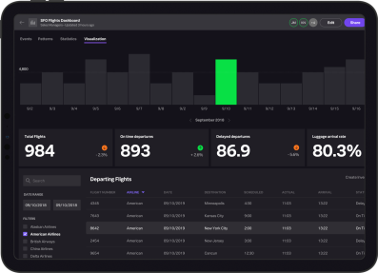
HEALTH CHECK AUTOMATION
Automation Server
VDI Systems
Log REST API’s
VDI API’s
PHASE 1
HC REST API’s
Log REST API’s
VDI API’s
PHASE 2
HC REST API’s
Angular UI
Splunk Dashboard

Slide 3
HEALTH CHECK AUTOMATION (VDI)
Health check Jar’s and Scripts are deployed in VDI
VDI Systems
Automation Server
Log REST API’s
VDI API’s
Log REST API’s
VDI API’s
Splunk Dashboard

Slide 4
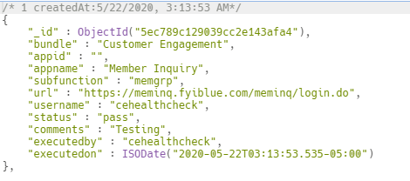
LOGGING FRAMEWORK API’s
Env | Logging Framework API’s | Fields
Test | https://atr.test.fyiblue.com/automation/logrest/api/v1/hc | bundle,appid,appname,subfunction,url, username,status,comments
Prod | https://atr.fyiblue.com/automation/logrest/api/v1/hc | bundle,appid,appname,subfunction,url, username,status,comments

Slide 5
AUTOMATION API FRAMEWORK FOR
GUI
VDI Systems
Automation Server
GUI REST API’s
Insert
Update
Get
Log REST API’s
Angular UI
Splunk Dashboard

Slide 6
GUI FRAMEWORK API’s
TEST
Function | API’s
Insert | https://atr.test.fyiblue.com/automation/guirest/api/v1/add/<collectionname>
Update | https://atr.test.fyiblue.com/automation/guirest/api/v1/update/<collectionname>? _id=xxxx
Get (All) | https://atr.test.fyiblue.com/automation/guirest/api/v1/fetch/<collectionname>
Get (by specific values) | https://atr.test.fyiblue.com/automation/guirest/api/v1/fetch/<collectionname>? key=value
PROD
Function | API’s
Insert | https://atr.fyiblue.com/automation/guirest/api/v1/add/<collectionname>
Update | https://atr.fyiblue.com/automation/guirest/api/v1/update/<collectionname>? _id=xxxx
Get (All) | https://atr.fyiblue.com/automation/guirest/api/v1/fetch/<collectionname>
Get (by specific values) | https://atr.fyiblue.com/automation/guirest/api/v1/fetch/<collectionname>? key=value

Slide 7


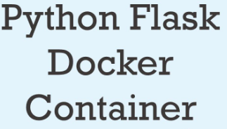

Service-now & Email Wrapper API’s
Automation Server
Create / Update incidents
Using SMTP

